Slide 1
J-K Flip-Flop
Joshua Gould
12/5/2018
ECE 09.414 VLSI Design
Dept. of ECE
Henry M. Rowan College of Engineering
Rowan University

Slide 2
Outline
J-K Flip-Flop Overview / Description
Features / Problems
Block Diagram
Truth Table
Master Slave Design
Design Choices
Logical Design
Worst Case Design
Logical Effort, Number of Stages, Delay
Gate Sizes for Optimized Design
Standard Cell Library & Layout Simulations
Conclusion

Slide 3
Overview
JK Flip-Flop with Clear
  like the SR flip-flop, includes a "toggle" function when inputs are set to 1.
  Outputs only change with a clock pulse (Synchronous)
J (set) and K (reset)
  In other words:
  J=1, K=0 sets the flip-flop
  J=0, K=1 resets the flip-flop
  J=1, K=1 toggles the flip-flop

Slide 4
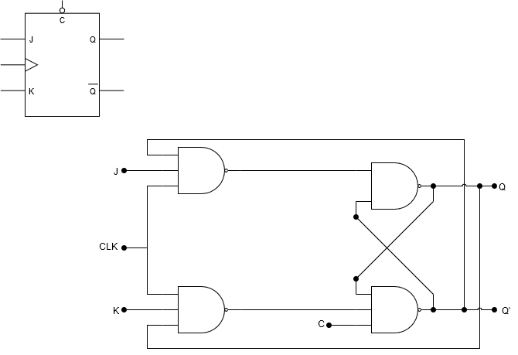
Block Diagram

Slide 5
Truth Table
Inputs |  |  |  | Outputs |  | Action
J | K | CLK | CLR | Q | Q’
0 | 0 | Edge | 0 | Last Q | Last Q’ | Retain State
0 | 1 | Edge | 0 | 0 | 1 | Reset Q
1 | 0 | Edge | 0 | 1 | 0 | Set Q
1 | 1 | Edge | 0 | Last QN | Last Q | Toggle
0 or 1 | 0 or 1 | 0 or 1 | 1 | 0 | 1 | Asynchronously Reset Q
0 or 1 | 0 or 1 | 0 or 1 | 1 | Last Q | Last QN | Illegal State

Slide 6
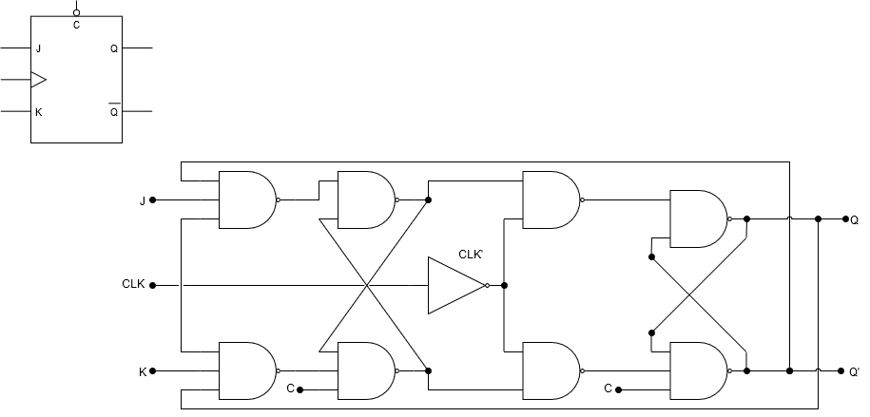
Master/Slave Flip-Flop
Single flip-flops suffer from “race” timing problems
Race timing occurs if the output Q changes state before the timing pulse of the clock input has time to go “OFF”.

Slide 7
Master/Slave Flip-Flop
Master Latch
Slave Latch
Two latch stages in a cascaded configuration
Activated with opposite clock phases
Eliminates uncontrolled oscillations since only one stage is active at any given time

Slide 8
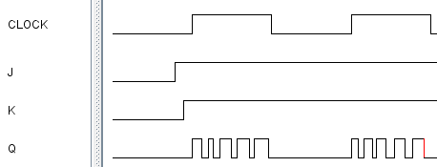
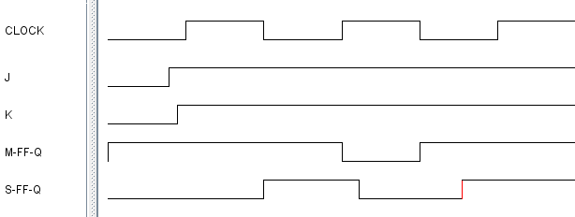
Master/Slave Flip-Flop
M
S
Uncontrolled toggling when clock is high
Slave toggles half a clock cycle after the master latch

Slide 9
Design Overview
POSSIBILITY 1: Simple NAND Logic Gate
  PROS:
    Simple design
    Small design area
    Easily understandable
  CONS:
    Some constraints on the clock pulse width
    Minimized features
    32 Transistors Required

Slide 10
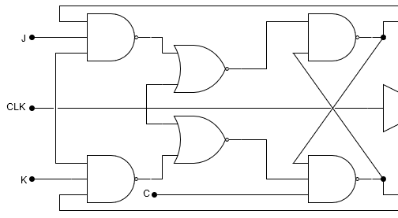
Design Overview
POSSIBILITY 2: Edge Triggered NAND-NOR
  PROS:
    Edge-triggered
    Easily understandable
  CONS:
    Inputs must be stable
    for some time before
    clock goes low.
    Higher power consumption
    Larger design area than NAND only (+2 NOR +2 NOT)
    44+ Transistors Required (Highest)
    Timing is slower

Slide 11
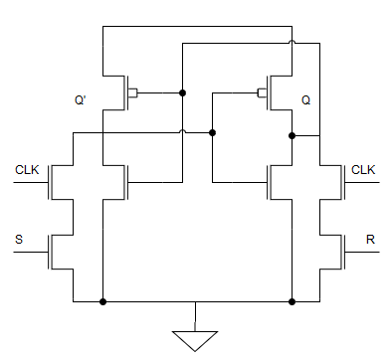
Design Overview
POSSIBILITY 3: Pass Transistors
S
R

Slide 12
Design Overview
POSSIBILITY 3: Pass Transistors
  PROS
    18 Transistors
    Smallest Logic Area
  CONS
    Additional components in
    latch area
    Bad for pull-up level

Slide 13
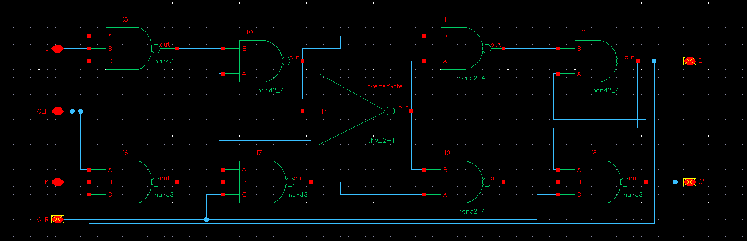
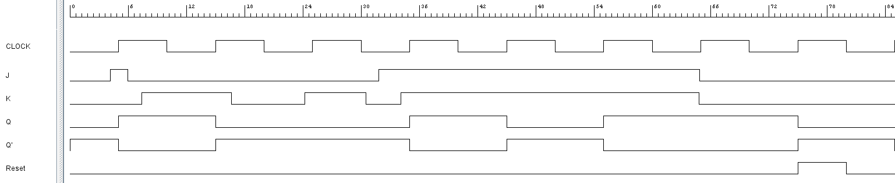
Logic Design

Slide 14
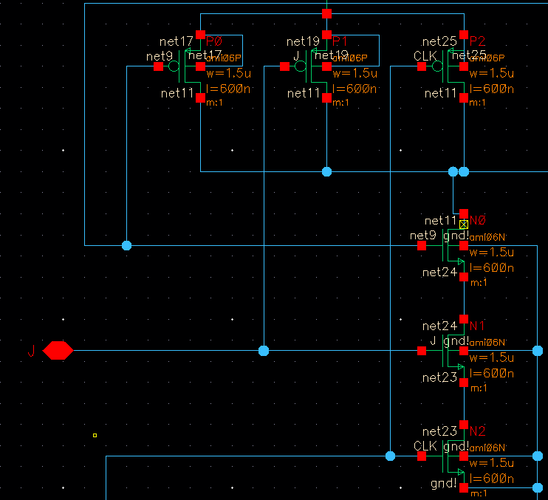
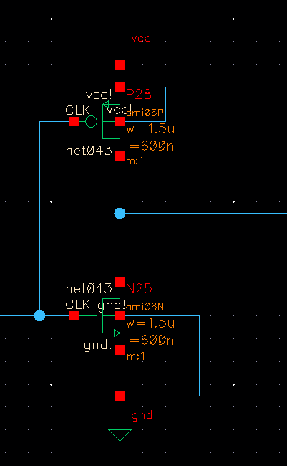
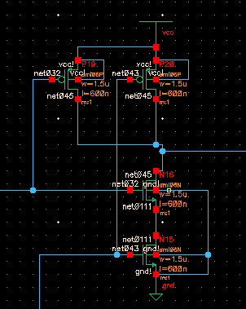
Transistor Design

Slide 15
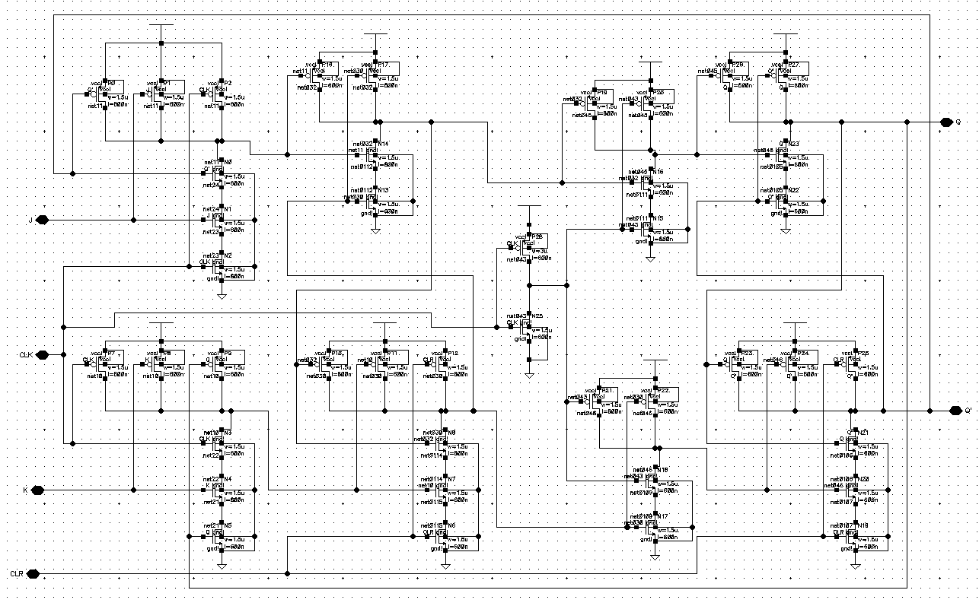
Transistor Design

Slide 16
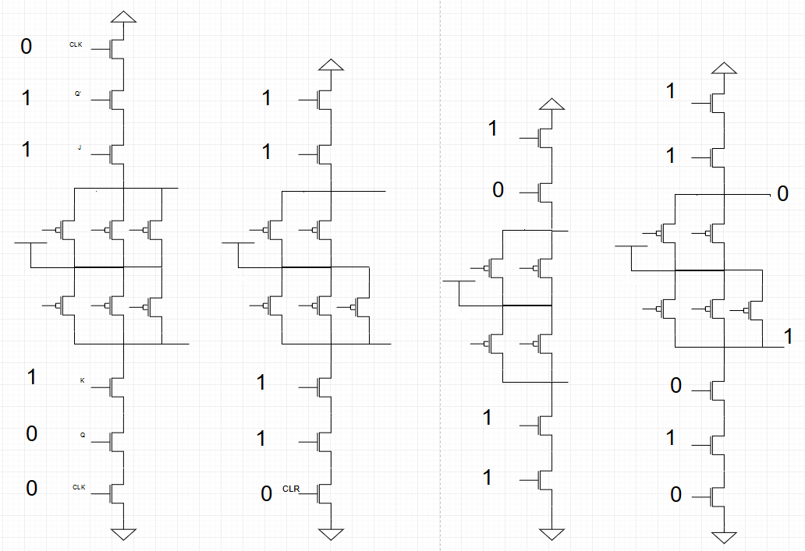
Worst Case Logical Path

Slide 17
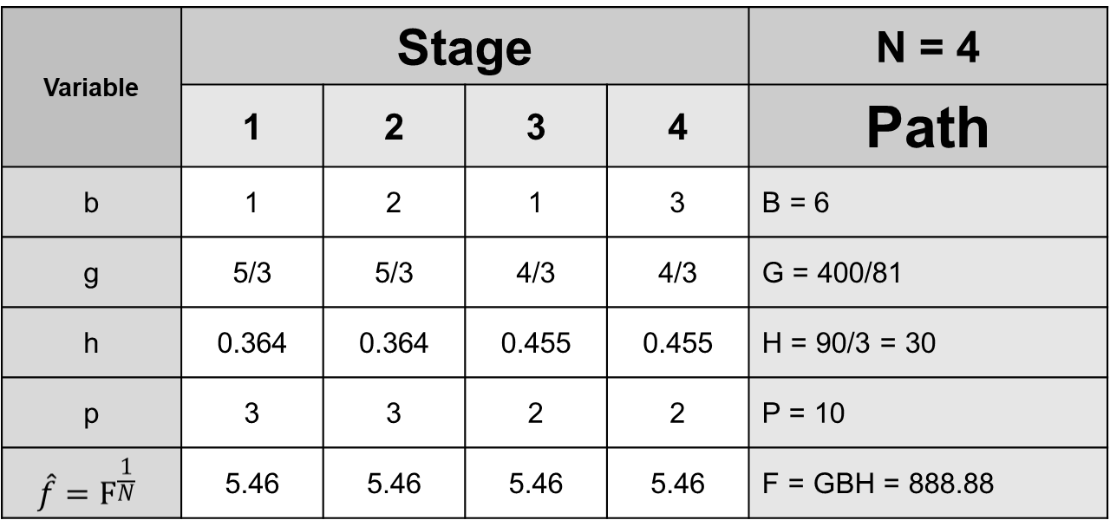
Logical Effort, Number of Stages, Delay

Slide 18
Spreadsheet Comparing Different Designs
Design | N | G | P | D
NAND3-NAND2-NOT | 6 | 5.62 | 10 | 32.86
INV-NAND3-INV-NOR4 | 4 | 5 | 9 | 28.8
INV-NAND3-INV-NOR4-INV-INV | 6 | 5 | 11 | 28.43
INV-NAND2-NAND2-INV-NAND2-NAND2 | 6 | 3.16 | 10 | 26.5
INV-NAND2-NAND2-INV-NAND2-NAND2-INV-INV | 8 | 3.16 | 12 | 29.05

Slide 19
Gate Sizes for Optimized Design
R | 9.828 | V | 9.828 | Z | 1.810
S | 32.197 | W | 32.197
T | 131.847 | X | 131.847
U | 21.978 | Y | 21.978

Slide 20
Standard Cell Library

Slide 21
Standard Cell Library Layouts

Slide 22
Standard Cell Library Extracted Layouts

Slide 23
Standard Cell Library Simulation
“Spectre” Netlist

Slide 24
Standard Cell Library Simulation
Input / Output Waveforms

Slide 25
Snap-together Standard Cells
Circuit Layout

Slide 26
Snap-together Standard Cells Simulation
Input / Output Waveform

Slide 27
Delay Comparison
Logical Effort vs. Spectre

Slide 28
Conclusions

